Slide 1
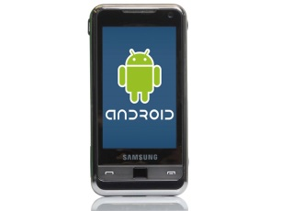
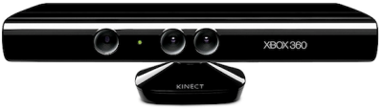
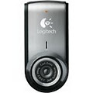
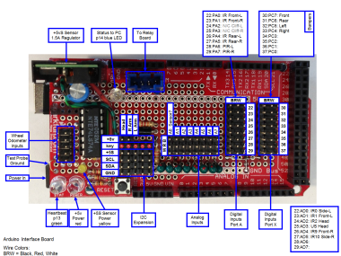
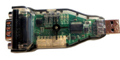
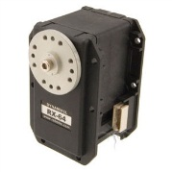
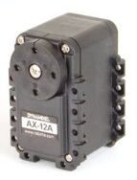
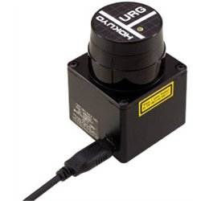
Loki USB Hardware Diagram
Laptop Computer
Bluetooth
Bluetooth for commands from Android Phone
Kinect
Microsoft Kinect. Tilt Controlled byAX12 Servo
Left Camera
Logitech QuickCam Pro
Right Camera
Logitech QuickCam Pro
Arduino
Arduino Mega – handles sensor input, Led lights, etc.
USB Hub
Kerr Motor Controller, controls a Pittman motor for each shoulder
Shoulder
Servos
USB2Dynamixel controls Dynamixel MX servos
Wheels
Pololu Trex Motor controller, drives Pittman wheel motors
Laser Ranger
Hokuyo URG-04LX-UG01 Laser Rangefinder (optional)

Slide 2
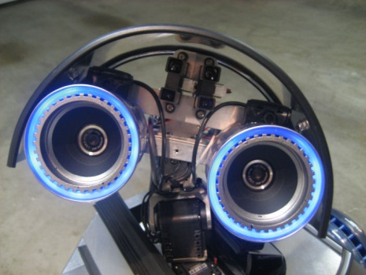
Sensors & Control
Top
Mid Upper
Mid
Mid Lower
Bottom
Laptop Computer
Head
PCF 8574
LED “Eyes”
Left Arm
PCF 8574
GP2Y0D340K IR Bumper
I2C-IT IR Sensors
Arduino
Right Arm
PCF 8574
GP2Y0D340K IR Bumper
I2C-IT IR Sensors
I2C
Arduino Interface Shield
Hamamatsu P5587 Wheel Motor Monitor
Left and Right Wheel Monitors
Hamamatsu P5587 Wheel Motor Monitor
I2C Compass
Bumper Switches
Body Lights
Sharp IR Ranges (4)
Front and Side IR Rangers

Slide 3
GUI Thread
Robot Control Engine
Read Thread
User Interface
Config and
Manual Control
Arduino
Sensor
Control Thread Queue
Write Thread
Blue- Smirf
Sensor Data
Control
Remote Control over IP
Socket Read Thread
Control Modules
Sensor Fusion
Android Phone
Socket
Write Thread
User Command
Collision
Drive Control Arbitrator
Pololu Trex
Priority
Motor Thread
General Timers Poll Sensors Keep Alive Ping
Watchdog timeouts
Object Avoidance
Timer Thread
Dyna 2 USB
Servo Control Arbitrators
Smart Servo Thread
Behaviors
Kerr Control
Kerr Thread
Navigation
Bluetooth
Laser Thread
Depth Thread
Kinect Threads
Laser Range
Read Laser Add XY, Object Avoidance and Navigation
Depth Processing
Read Kinect Data Convert Range to XYZ Point Cloud
Kinect App Communication
Camera Threads
Camera App Communication
Kinect C# App
Depth Capture
+ Speech Reco
Vision Processing
Face Recognition Object Detection etc.
Camera App

Slide 4
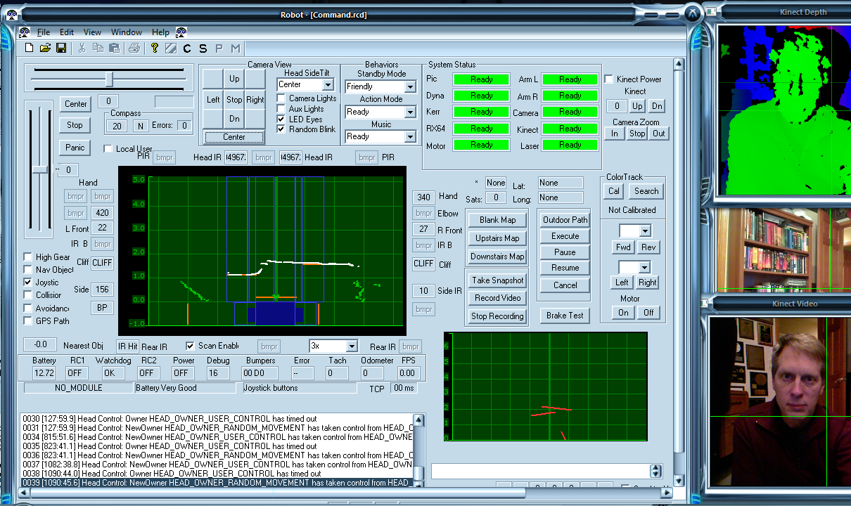

Slide 5
